Slide 1

AI-Driven polymer aging prediction using raman spectroscopy
Predicting polymer aging and recyclability through machine learning
Presented by: Jinku Jung and Professor Sanmukh Kuppannagari
For: Summer AIRE Project 2026

Slide 2
AI-Driven Polymer Aging Prediction and Classification System
Goal: To predict polymer aging from Raman spectra
  Why it matters (project rationale):
    Better recycling decisions are possible.
    Faster material characterization in monomer-chain transfer monomer reaction analysis.
    Reproducible AI workflow: For ia hpc-bound datasets (to OSC, Case, or Microsoft Azure), using pytorch, tensorflow, and conda code can balance the workload of empirically observed reaction values.
    for input parameters to be computed remotely and not crash/lock up your laptop for 500 input values→5.95 hours on a laptop-based intel core ultra 7 cpu.
    This code is extensible to nvidia gpu cuda core computation to save computing time of the average medical researcher running pet-raft ctm kinetic reaction data analysis: the real magic of artificial intelligence/machine learning based computer programming source code and remote hpc gpu computing in tandem—if and when necessary and appropriate.
  Long-term Vision:
    Raman
    FTIR
    Image-based models

Slide 3
Model Architectures
Figure2CNN | ResNet1D | ResNet18Vision
Baseline model from literature. | Deeper candidate spectral model with skip connections. | Future Image-focused CNN architecture model, retrained on polymer dataset (roadmap).
Future expansions will add additional trained CNNs, supporting direct benchmarking and comparative reporting.

Slide 4
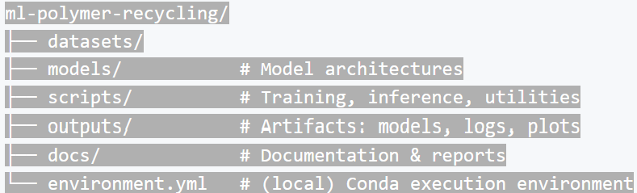
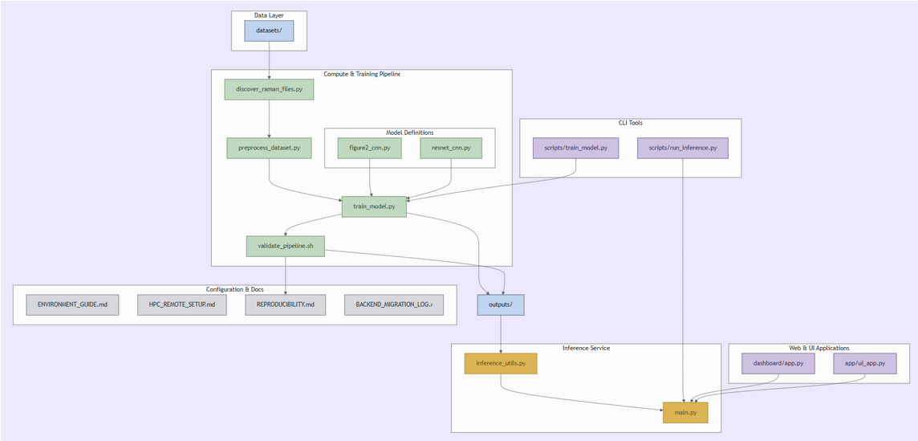
Project Structure (Cleaned and Current)
Dataset→ Preprocessing→ Training→ Validation→ Prediction (Output Data To Form a Conclusion)

Slide 5
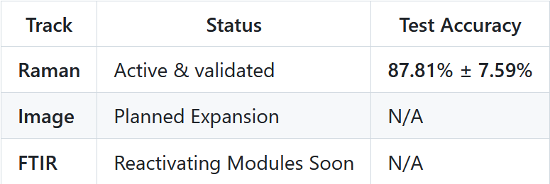
Current Status
Key Features
10-Fold Stratified Cross-Validation
CLI Training: train_model.py
CLI Inference run_inference.py
Output artifact naming per model
Raman-only preprocessing with baseline correction, smoothing, normalization
Structured diagnostics JSON (accuracies, confusion matrices)
Canonical validation script (validate_pipeline.sh) confirms reproducibility of all core components

Slide 6
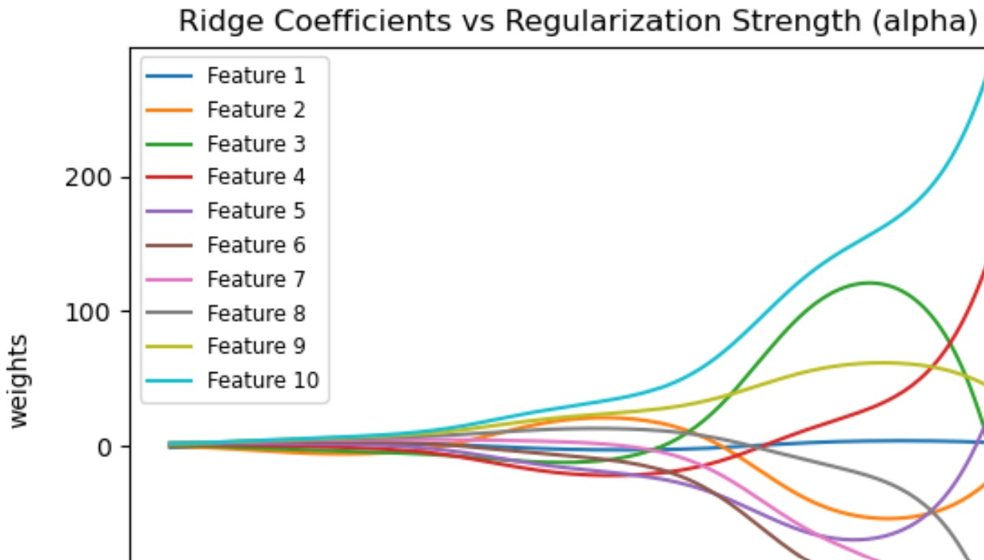
10-Fold Stratified Cross-Validation: a Feature Ridge-coefficient Trace graph
<sciKit linear regression statistics library>
A ridge trace from linear regression analysis reveals that, for small alpha trend analysis, other curve fitting is possible.
A ridge trace from linear regression analysis reveals that, for large alpha trend analysis, linear chi-squared fitting is most likely.

Slide 7
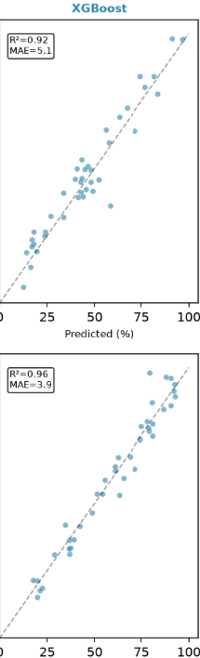
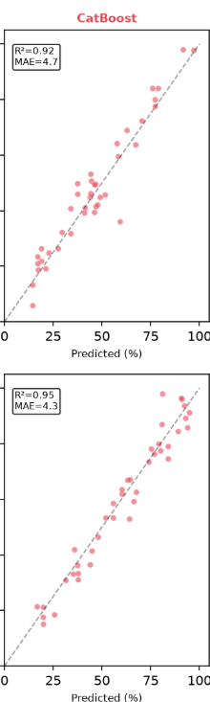
XgBoost and CatBoost Linear Regression Comparison

Slide 8
What XGBoost Does:
Handles Tabular Data Best
Manages missing values
Prevents curve overfitting
Captures Non-Linear Relationships
Features Parallel computing

Slide 9
What catboost does:
Native Categorical encoding
Prevents Target Leakage
Exceptional default settings
Ultra-fast real-time inference
Highly Efficient GPU Training

Slide 10
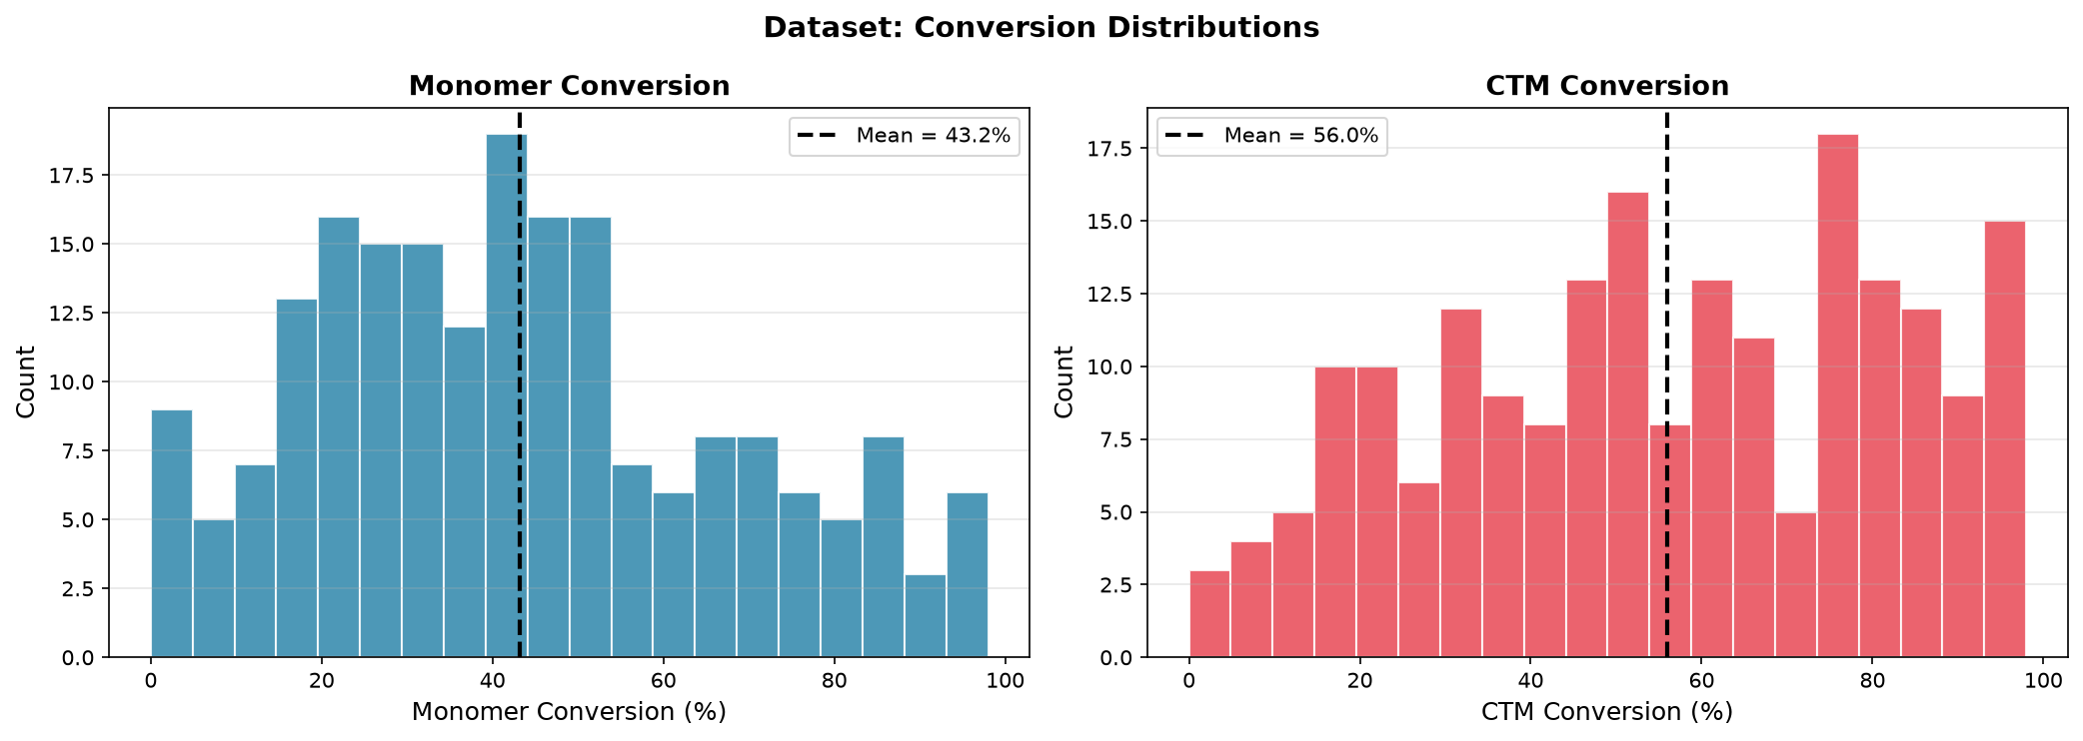
Dataset: Conversion Distributions
This is a chart that documents the correlation between reactant monomers and chain transfer monomers into …
Their observed product yield through their absence after certain timesplice intervals are measured according to …
The elapsed time transpired afterward (1+, 2+, 3+, 4+, 5+, 6+, and 8+ hours after initial chemical reaction.

Slide 11
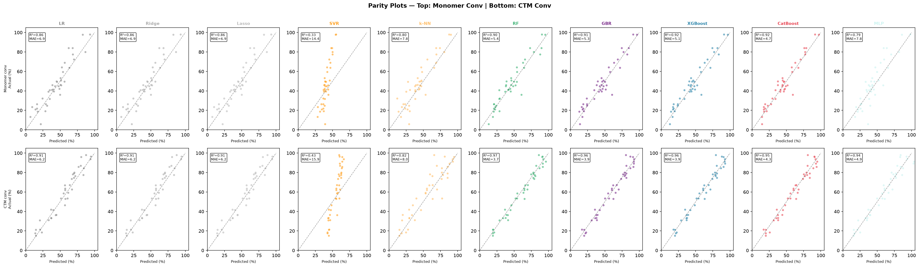
Parity Plots
Actual versus Predicted values:
  y_pred = model.predict(X_test)
    x-axis: actual values (empirical), y_test
    y-axis: predicted values (theoretical), y_pred
In layman’s terms: how close observed values in product yield “match up” with predicted values from the chemical equation and molar quantities of reactants→expected product yield.

Slide 12
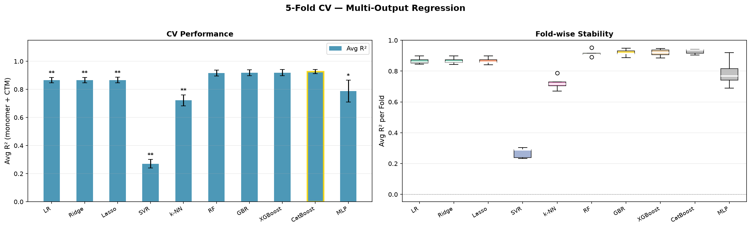
CV Comparison
This is a visualization of a five-fold sampled cross-validation chart.
When trained and evaluated 5 times as a statistical model, the results are mean-averaged.
If similar scores are observed across successive empirically observed (trained) <READ: SAMPLED> and are congruent with mutually exclusive <READ: COMPARED AGAINST> (tested) test intervals known as folds, then the statistical model is valid.

Slide 13
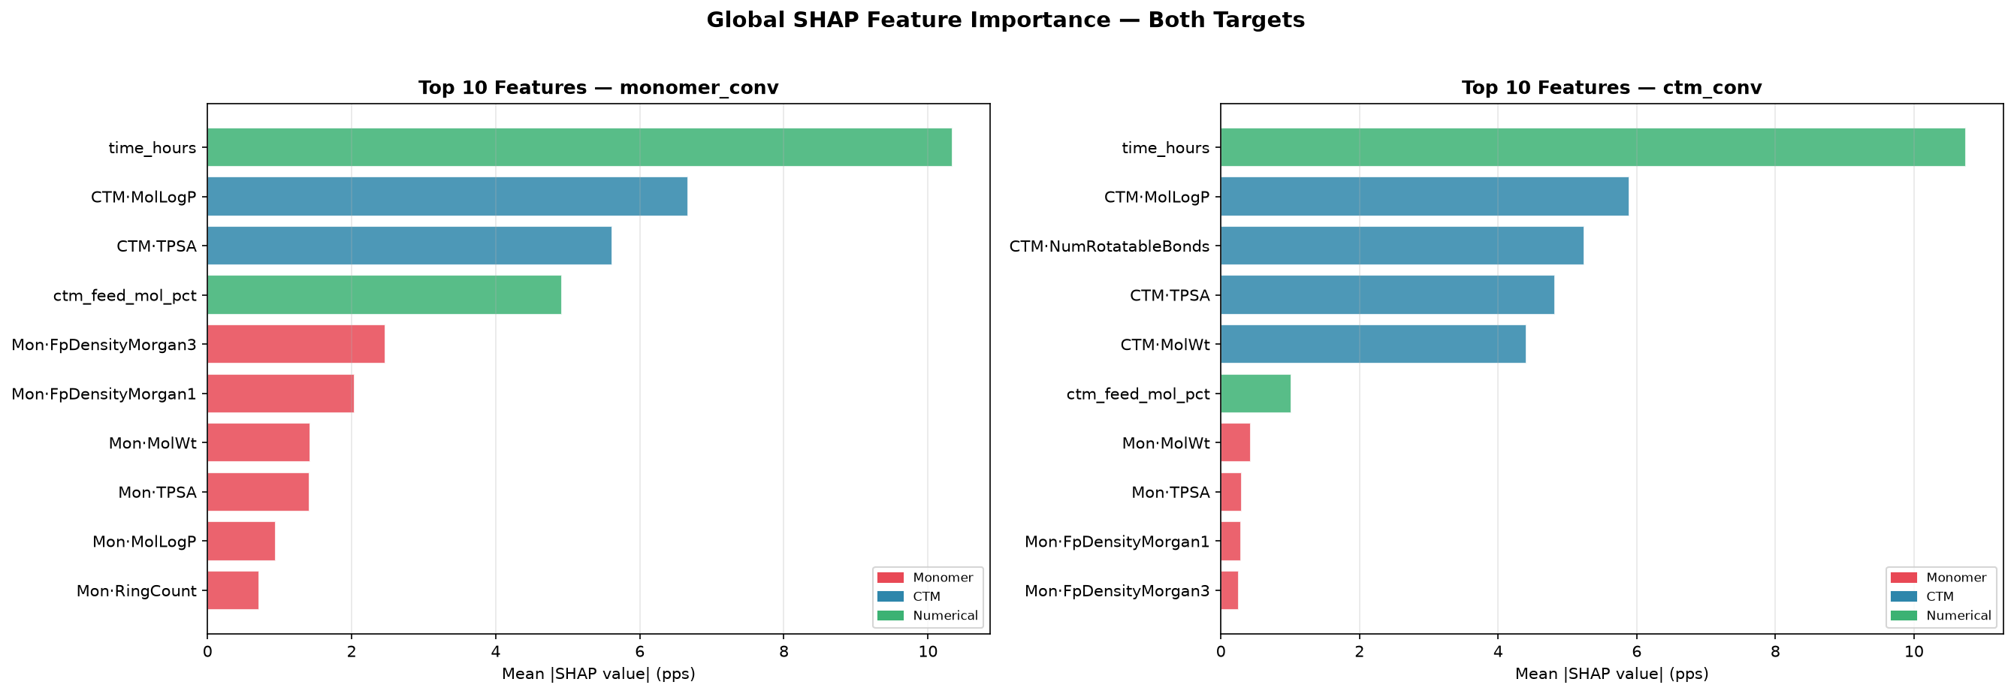
Monomer number was the most important predictor of conversion--graphical conclusions below:

Slide 14
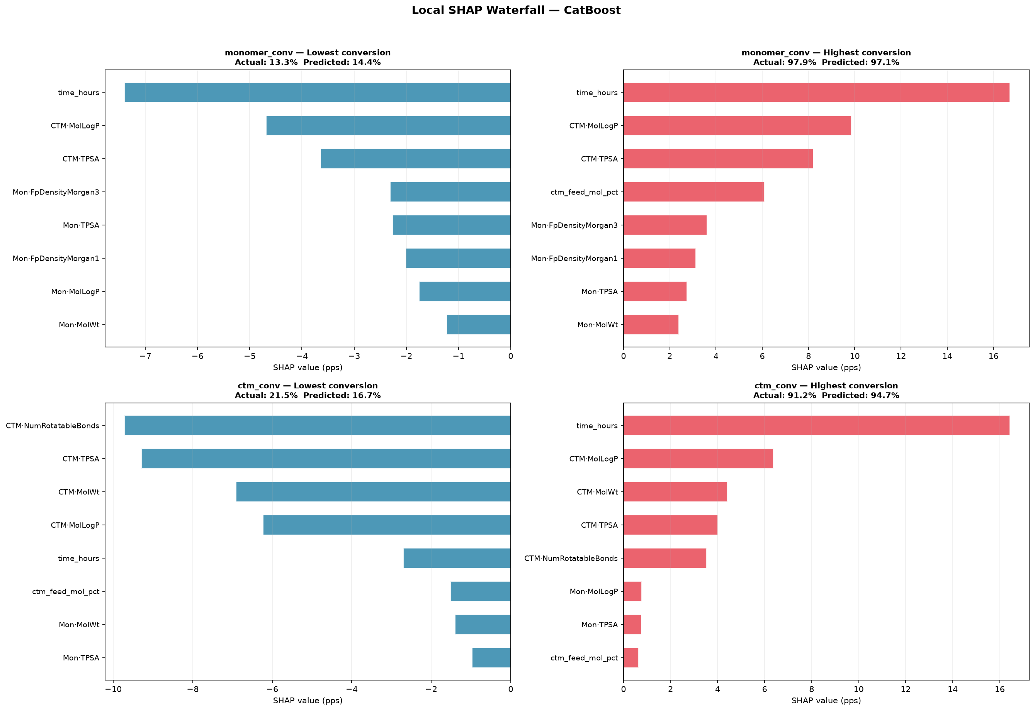
SHAP Waterfall Graph

Slide 15
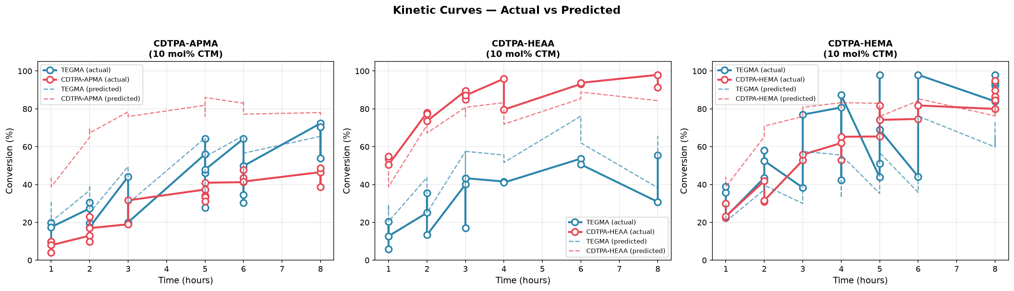
Kinetic curves Graphs

Slide 16
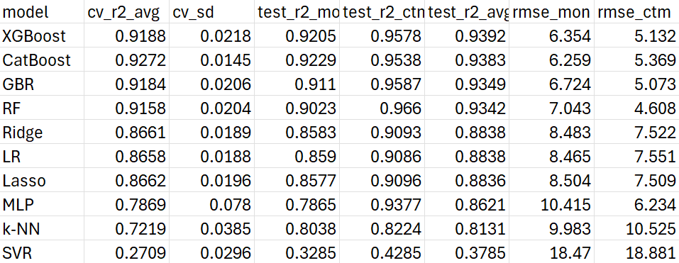
Results summary chart Output data
<CTM Kinetic conversion prediction>
Conclusion: Here, the CatBoost software code achieved the best balance
of accuracy and precision to validate stability:
  Among target chain transfer monomers <as experimental reactant variables>
  CDTPA-HEMA, CDTPA-HEAA, CDTPA-APMA that …
  Bind to the lone TEGMA monomer <as an empirically analyzed as a control
reactant variable> to form …
  Empirically observed reaction products of molar percentage yield and
measurable time per reaction.

